Slide 1
Peer-graded Assignment: Capstone Project - The Battle of Neighborhoods (Week 2)
Final Report:
Analysing and visualizing the Indian Restaurants in NYC
Saurabh Kumar

Slide 2
NYC
As per information available on Wikipedia
New York City (NYC) is the most populous city in the United States; with an estimated 8,336,817 residents as of July 2019 distributed over about 302.6 square miles (784 km²).
New York City has also been a major point of entry for immigrants; Approximately 37% of the city's population is foreign born, and more than half of all children are born to mothers who are immigrants.
The New York region continues to be by far the leading metropolitan gateway for legal immigrants admitted into the United States.
As many as 800 languages are spoken in New York, making it the most linguistically diverse city in the world.
New York is home to more than 3.2 million residents born outside the United States, the largest foreign-born population of any city in the world as of 2016
New York contains the highest total Asian population of any U.S. city proper. The metropolitan area is also home to 20% of the nation's Indian Americans.
English remains the most widely spoken language, although there are areas in the outer boroughs in which up to 25% of people speak English as an alternate language, and/or have limited or no English language fluency.
English is least spoken in neighbourhoods such as Flushing, Sunset Park, and Corona.
With its diverse culture, comes diverse food items. There are many restaurants in New York City, each belonging to different categories like Chinese, Indian, and French etc.

Slide 3
Introduction
Background: I am a freelance food blogger and I want to analyse the Indian Restaurant availability in the NY city and help my followers to get the details related to Indian Restaurant availability in different parts of NY city.
Problem: This capstone project aims to explore the NY city to list and visualize the parts of the area which has some great Indian restaurants, potential market/area to open the Indian restaurant, the areas which has lack of Indian restaurants and which is the best place to live in NY city if you prefer Indian cuisines as well.

Slide 4
Problem statement
To locate and recommend to the client which neighbourhood in New York City will be best choice to start a restaurant. Before opening a new restaurant in NYC, the data science team will provide data and insight to:-
By this project we will address the answer for the below major questions:
Q1) All major parts of NYC which has great Indian restaurants(listing Using Visualization).
Q2) Best location in New York City for Indian Cuisine.
Q3) Potential market for Indian Restaurant.
Q4) Areas lack of Indian Restaurants.
Q5) Best place to stay for the lover of Indian cuisines.

Slide 5
Data source descriptions
New York City's demographics show that it is a large and ethnically diverse metropolis. With its diverse culture, comes diverse food items. There are many restaurants in New York City, each belonging to different categories like Chinese, Indian, and French etc.
To address this problem we need the following data:
New York City data that contains list Boroughs, Neighbourhoods along with their latitude and longitude.
Data source : https://cocl.us/new_york_dataset
Description: This data set contains the required information. And we will use this data set to explore various neighbourhoods of New York City
Indian restaurants in each neighbourhood of New York City.
Data source : Foursquare API
Description: By using this API we will get all the venues in each neighbourhood. We can filter these venues to get only Indian restaurants.
Geo Space data
Data source : https://data.cityofnewyork.us/City-Government/Borough-Boundaries/tqmj-j8zm
Description: By using this geo space data we will get the New York Borough boundaries that will help us visualize choropleth map.

Slide 6
methodology
We begin by collecting the New York city data from the following link "https://cocl.us/new_york_dataset“
We will find all venues for each neighbourhood using Foursquare API.
We will then filter out all venues with Indian restaurant for further analysis.
Next using Foursquare API, we will find the Ratings, Tips, and Number of Likes for all the Indian Restaurants.
We will then sort Neighbourhoods and Borough the data keeping Ratings as the constraint.
Next we will consider all the neighbourhoods with average rating greater or equal 8.0 to visualize on map.
We will join this dataset to original New York data to get longitude and latitude.
Finally, we will visualize the Neighbourhoods and Borough based on average Rating using python’s Folium library.

Slide 7
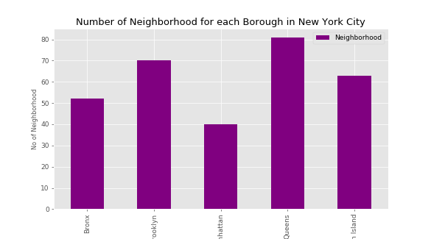
Number of Neighbourhood for each Borough in New York City

Slide 8
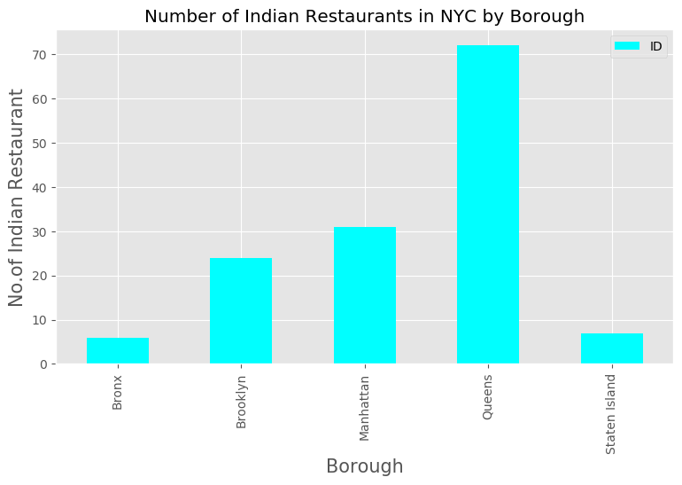
Number of Indian Restaurants in NYC by Borough

Slide 9
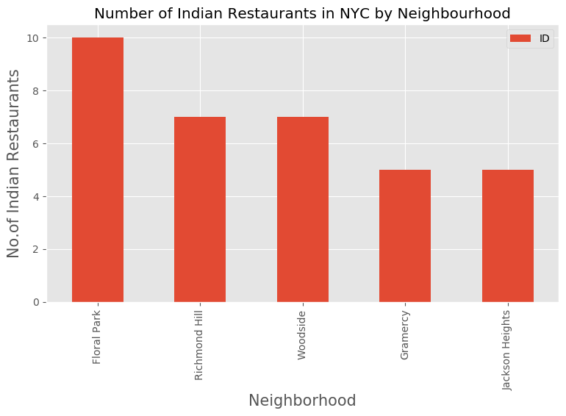
Number of Indian Restaurants in NYC by Neighbourhood

Slide 10
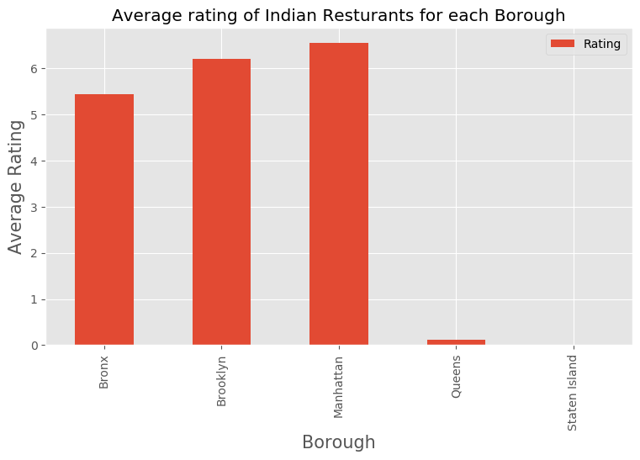
Average rating of Indian Resturants for each Borough

Slide 11
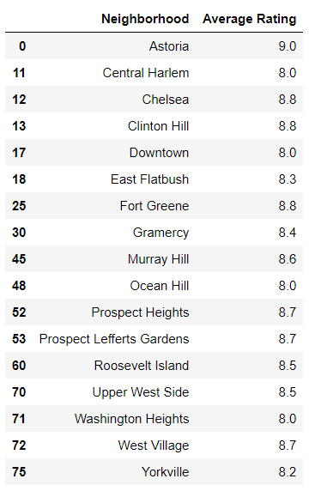
Top Rated Restaurants in NYC

Slide 12
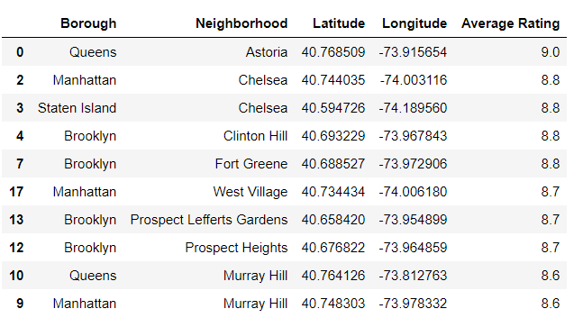
Details of Top Rated NYC Indian Restaurants

Slide 13
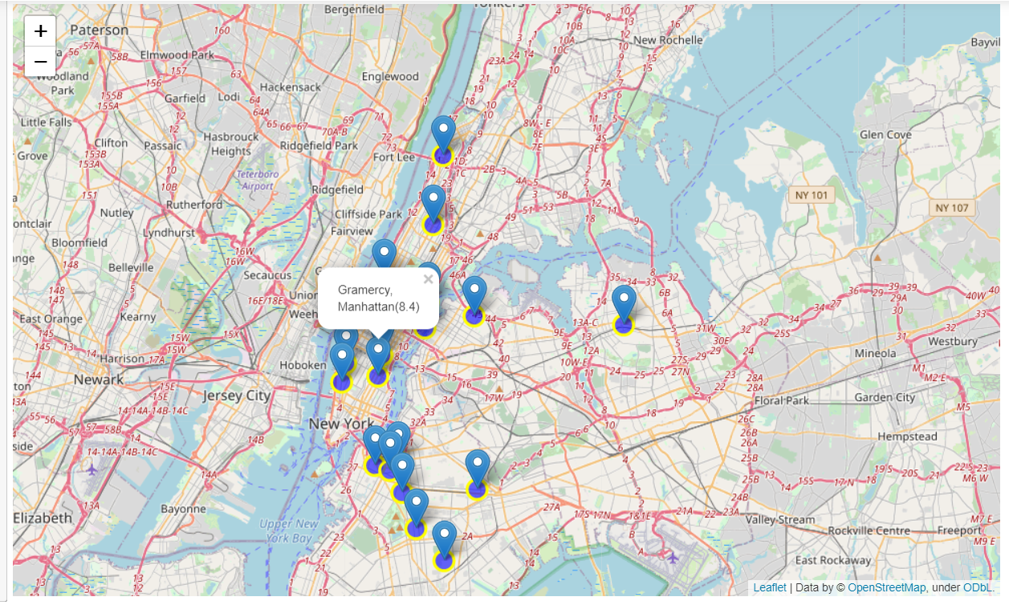
Visualizing on the map

Slide 14
Conclusion
Murray Hill, Tribeca, Midtown in Manhattan are some of the best neighbourhoods for Indian cuisine.
Bronx has the lowest rated Indian Restaurant's in NYC.
Manhattan is the best place to stay if you prefer Indian Cuisine.
Recommendation
Midtown or Tribeca in Manhattan would be the best choice to start a restaurant given that
it is the third most populous urban area in New York City (NYC).
it has a population density of 27,826 people per square km, highest of any borough in the United States.
it has some of the top rated Indian restaurants located in that area
It has the second highest Asian ethnic minority population in NYC.

